Slide 1
Support 6

Slide 2
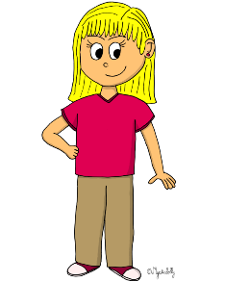
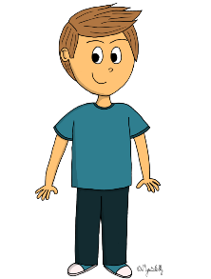
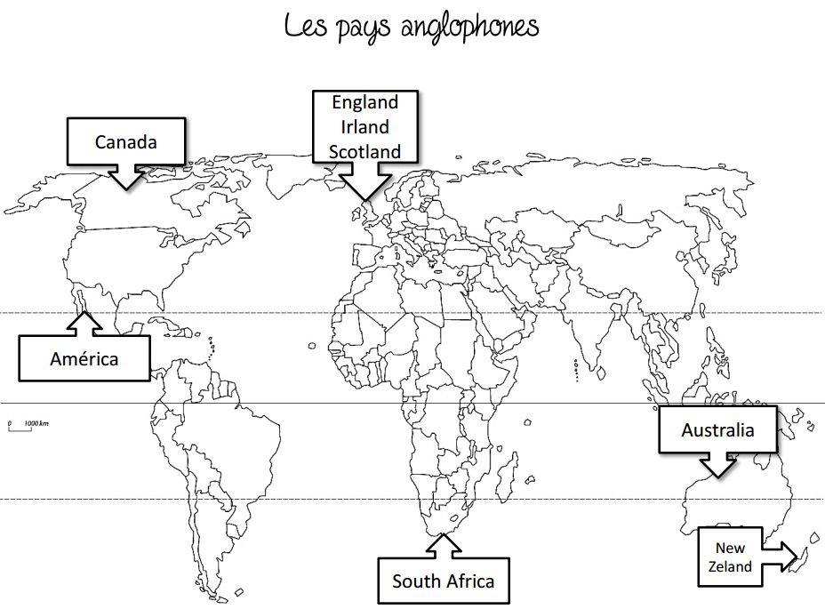
MARK
BEN
JOHN
United States

Slide 3
MARK
BEN
JOHN
United States

Slide 4
MARK
BEN
JOHN
I am years old.
37
27
47

Slide 5
MARK
BEN
JOHN
I am years old.
37
1
27
47

Slide 6
Listen to the recording and tick the correct box :
 | True | False | I don't know
He is a painter.
He doesn't like running.
His name is Marvin.
He has got one brother and two sisters. *
He likes football.
He is a boy.
His phone number is 07527082043.
He is seventeen years old.
He has a dog.
He comes from England.
*She has got... = UK She has... = USA

Slide 7
Listen to the recording and tick the correct box :
 | True | False | I don't know
He is a painter.
He doesn't like running.
His name is Marvin.
He has got one brother and two sisters. *
He likes football.
He is a boy.
His phone number is 07527082043.
He is seventeen years old.
He has a dog.
He comes from England.
*She has got... = UK She has... = USA

Slide 8
Listen to the recording and answer these questions .
1. What's his name ? ___________________________________________________
2. How old is he ? _____________________________________________________
3. Where does he come from ? ___________________________________________
4. What's his phone number ? ____________________________________________
5. What does he like ? __________________________________________________
6. What does he not like ? _______________________________________________
7. Does he have any brothers and sisters ? __________________________________ 8. What’s his job? ______________________________________________________

Slide 9
Listen to the recording and answer these questions .
1. What's his name ? His name is Mark.
2. How old is he ? He is seven years old.
3. Where does he come from ? He comes from England.
4. What's his phone number ? His phone number is 075 270 820 43
5. What does he like ? He likes football.
6. What does he not like ? He does not like walking.
7. Does he have any brothers and sisters ? He has one brother and one sister. 8. What’s his job? He is a painter.

