Slide 1
Support 4

Slide 2
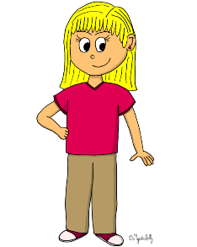
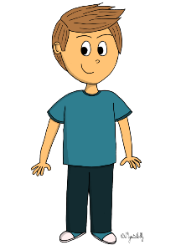
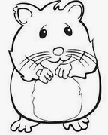
NINA
LEYLA
OLIVER

Slide 3
NINA
LEYLA
OLIVER

Slide 4
LEYLA
NINA
OLIVER

Slide 5
LEYLA
NINA
OLIVER

Slide 6
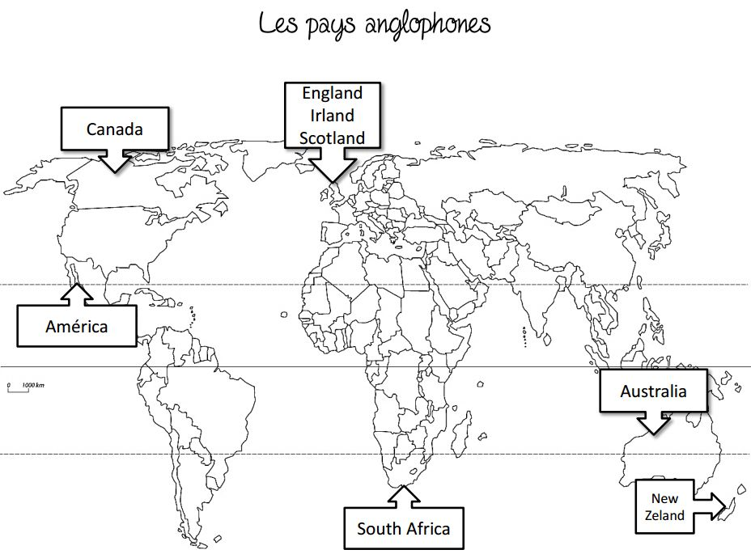
NINA
LEYLA
OLIVER
I am years old.
30
12
60
United States

Slide 7
NINA
LEYLA
OLIVER
I am years old.
30
12
60
United States

Slide 8
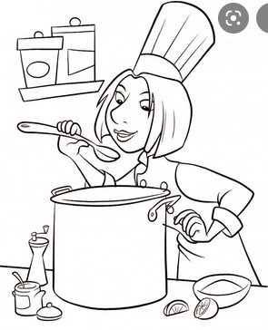
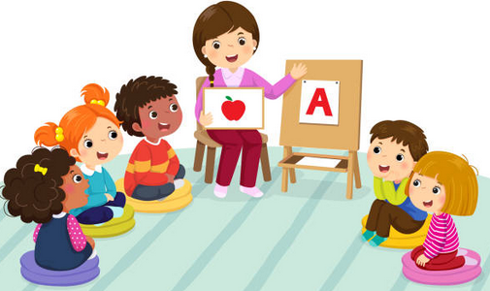
NINA
LEYLA
OLIVER
I am years old.
United States

Slide 9
NINA
LEYLA
OLIVER
I am years old.
30
United States

Slide 10
Listen to the recording and tick the correct box :
 | True | False | I don't know
She is a chef.
She doesn't like hiking.
Her name is Leyla.
She has two brothers.*
She doesn't like pizza.
She likes apples.
Her phone number is 3149406129.
She is thirty five years old.
She has a cat and a hamster.
She comes from England.
*She has got... = UK She has... = USA

Slide 11
Listen to the recording and tick the correct box :
 | True | False | I don't know
She is a chef.
She doesn't like hiking.
Her name is Leyla.
She has two brothers.*
She doesn't like pizza.
She likes apples.
Her phone number is 314 940 6129.
She is thirty five years old.
She has a cat and a hamster.
She comes from England.
*She has got... = UK She has... = USA

Slide 12
Listen to the recording and answer these questions .
1. What's her name ? ___________________________________________________
2. How old is she ? _____________________________________________________
3. Where does she come from ? ___________________________________________
4. What's her phone number ? ____________________________________________
5. What does she like ? __________________________________________________
6. What does she not like ? _______________________________________________
7. Does she have any brothers and sisters ? __________________________________ 8. What’s her job? ______________________________________________________

Slide 13
Listen to the recording and answer these questions .
1. What's her name ? Her name is Leyla.
2. How old is she ? She is thirty years old.
3. Where does she come from ? She comes from The United States.
4. What's her phone number ? Her phone number is 314 940 6129.
5. What does she like ? She likes apples.
6. What does she not like ? She does not like hiking.
7. Does she have any brothers and sisters ? She has one sister. 8. What’s her job? She is a chef.

