Slide 1
Support 3

Slide 2
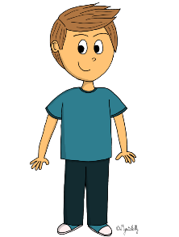
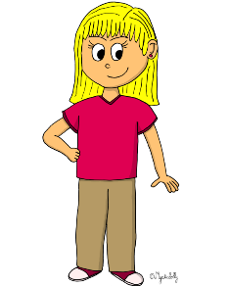
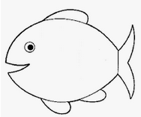
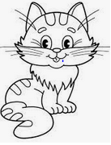
NINA
MARC
ELIZABETH

Slide 3
NINA
MARC
ELIZABETH

Slide 4
MARC
ELIZABETH
NINA

Slide 5
MARC
ELIZABETH
NINA

Slide 6
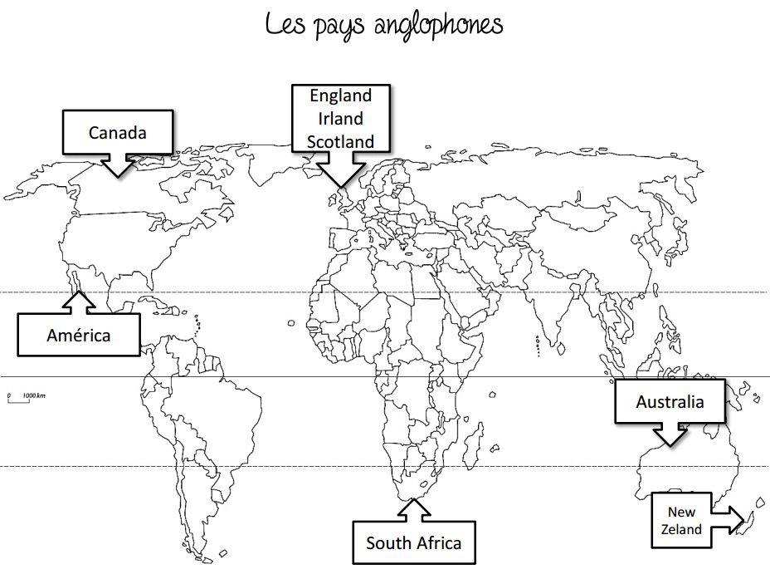
NINA
ELIZABETH
MARC
I am years old.
10
4
8
United States

Slide 7
NINA
ELIZABETH
MARC
I am years old.
10
4
8
United States

Slide 8
NINA
ELIZABETH
MARC
I am years old.
United States

Slide 9
MARC
2
NINA
ELIZABETH
1
I am years old.
8
United States

Slide 10
Listen to the recording and tick the correct box :
 | True | False | I don't know
She is a policewoman.
She doesn't like cheese.
Her name is Natalie.
She has four brothers.*
She doesn't like movies.
She likes basketball.
Her phone number is 9013378905.
She is eight years old.
She has two fish and a dog.
She comes from the United States.
*She has got... = UK She has... = USA

Slide 11
Listen to the recording and tick the correct box :
 | True | False | I don't know
She is a policewoman.
She doesn't like cheese.
Her name is Natalie.
She has four brothers.*
She doesn't like movies.
She likes basketball.
Her phone number is 9013378905.
She is eight years old.
She has two fish and a dog.
She comes from the United States.
*She has got... = UK She has... = USA

Slide 12
Listen to the recording and answer these questions .
1. What's her name ? ___________________________________________________
2. How old is she ? _____________________________________________________
3. Where does she come from ? ___________________________________________
4. What's her phone number ? ____________________________________________
5. What does she like ? __________________________________________________
6. What does she not like ? _______________________________________________
7. Does she have any brothers and sisters ? __________________________________

Slide 13
Listen to the recording and answer these questions .
1. What's her name ? Her name is Nina.
2. How old is she ? She is eight years old
3. Where does she come from ? She comes from the United States.
4. What's her phone number ? Her phone number is 9017261981.
5. What does she like ? She likes basketball.
6. What does she not like ? She doesn’t like cheese.
7. Does she have any brothers and sisters ? She has two brothers.

