Slide 1
Support 2

Slide 2
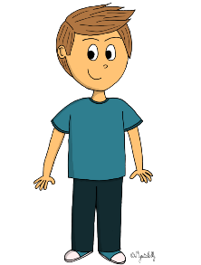
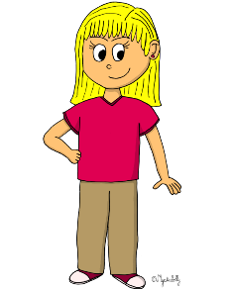
PETER
OLIVER
ELLEN
I am years old.
10
30
2

Slide 3
PETER
OLIVER
ELLEN
I am years old.
10
30
2

Slide 4
OLIVER
I am years old.
10
ELLEN
30
2
PETER

Slide 5
OLIVER
I am years old.
10
ELLEN
30
2
PETER

Slide 6
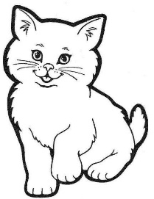
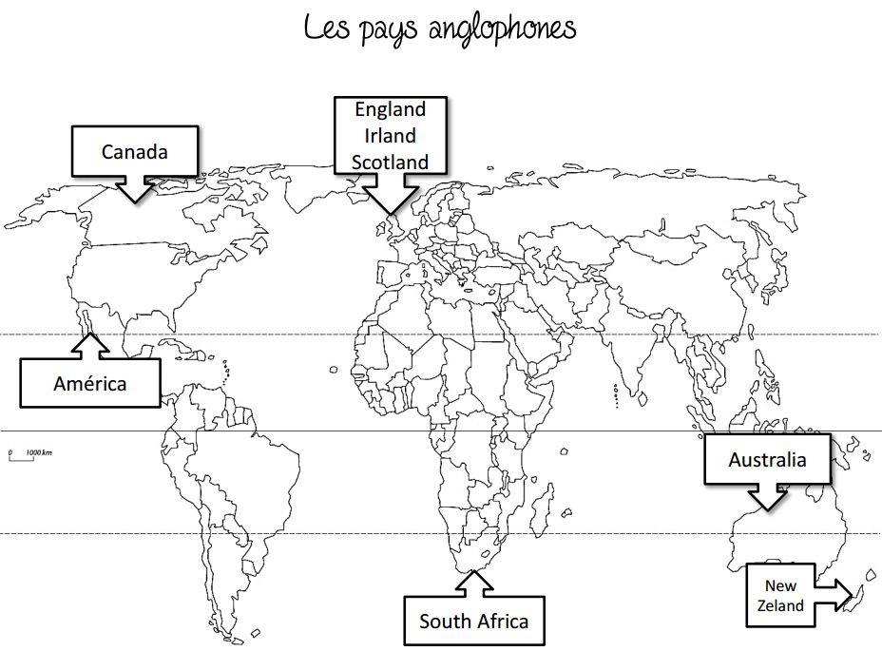
OLIVER
PETER
ELLEN
I am years old.
2
10
30
United States

Slide 7
OLIVER
PETER
ELLEN
4
I am years old.
2
10
30
United States

Slide 8
Listen to the recording and tick the correct box :
 | True | False | I don't know
He is a Policeman.
He doesn't like maths.
His name is Oliver.
He has got four sisters.*
He likes music.
He likes tomatoes.
His phone number is 0762814437.
He is thirty years old.
He has got three guinea pigs.
He comes from Australia.
*He has got... = UK He has... = USA
Policeman is capitalized because it is a profession that requires a certificate (not for teachers)

Slide 9
Listen to the recording and tick the correct box :
 | True | False | I don't know
He is a Policeman. |  | x
He doesn't like maths. | x
His name is Oliver. | x
He has got four sisters.* |  | x
He likes music. |  |  | x
He likes tomatoes. |  |  | x
His phone number is 0762814437. |  | x
He is thirty years old. | x
He has got three guinea pigs. |  | x
He comes from Australia.
*He has got... = UK He has... = USA
Policeman is capitalized because it is a profession that requires a certificate (not for teachers)

Slide 10
Listen to the recording and answer these questions .
1. What's his name ? _____________________________________________________
2. How old is he ? _______________________________________________________
3. What's his job ? _______________________________________________________
4. Where does he come from ? ____________________________________________
5. What's his phone number ? _____________________________________________
6. What does he like ? ____________________________________________________
7. What does se not like ? ________________________________________________
8. Does he have any brothers and sisters ? ____________________________________

Slide 11
Listen to the recording and answer these questions .
1. What's his name ? His name is Oliver.
2. How old is he ? He is thirty years old
3. What's his job ? He’s a Doctor.
4. Where does he come from ? He comes from Australia.
5. What's his phone number ? His phone number is 07 62 81 44 39.
6. What does he like ? He likes cooking.
7. What does he not like ? He doesn’t like maths.
8. Does he have any brothers and sisters ? He has three sisters.

