Slide 1
Support 1

Slide 2
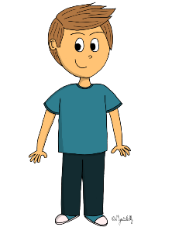
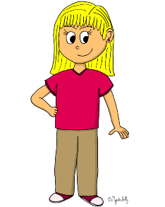
OLIVER
MARC
ELIZABETH

Slide 3
OLIVER
MARC
ELIZABETH

Slide 4
ELIZABETH
MARC
OLIVER

Slide 5
ELIZABETH
MARC
OLIVER

Slide 6
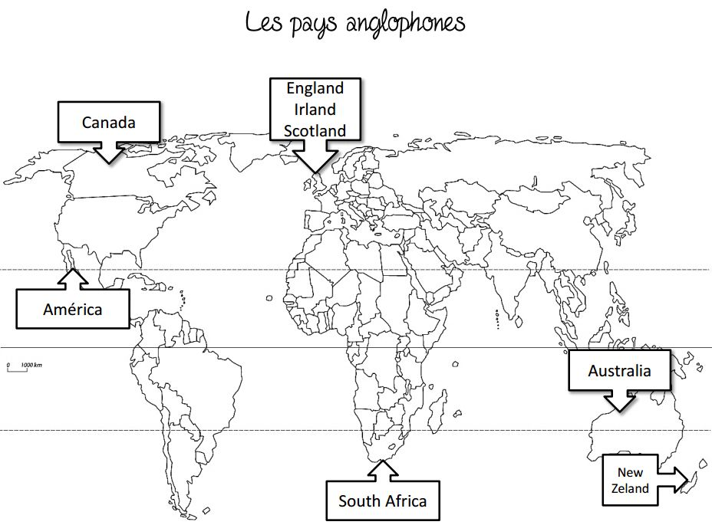
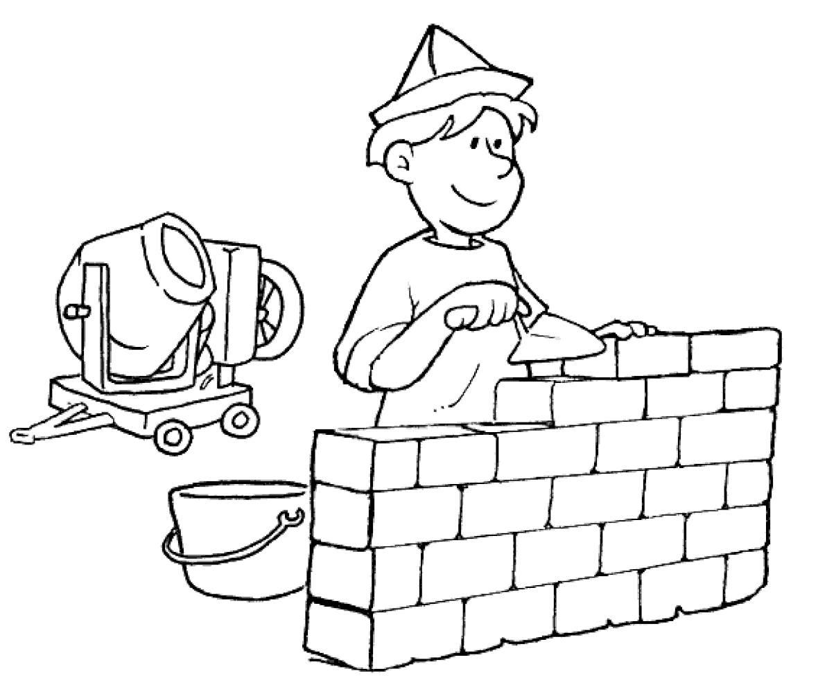
OLIVER
ELIZABETH
MARC
I am years old.
23
12
10
United States

Slide 7
2
OLIVER
ELIZABETH
MARC
I am years old.
23
12
10
United States

Slide 8
Listen to the recording and tick the correct box :
 | True | False | I don't know
She is a nurse.
She doesn't like tennis.
Her name is Elizabeth.
She has got two sisters.*
She doesn't like music.
She likes tomatoes.
Her phone number is 9405364496.
She is twenty-three.
She has got two dogs and a cat.
She is from the United States.
*She has got... = UK She has... = USA

Slide 9
Listen to the recording and tick the correct box :
 | True | False | I don't know
She is a nurse. | x
She doesn't like tennis. |  |  | x
Her name is Elizabeth. | x
She has got two sisters.* |  | x
She doesn't like music. |  | x
She likes tomatoes. |  |  | x
Her phone number is 9405364496. | x
She is twenty-three. | x
She has got two dogs and a cat. |  | x
She is from the United States. | x
*She has got... = UK She has... = USA

Slide 10
Listen to the recording and answer these questions .
1. What's her name ? _____________________________________________________
2. How old is she ? _______________________________________________________
3. What's her job ? _______________________________________________________
4. Where does she come from ? ____________________________________________
5. What's her phone number ? _____________________________________________
6. What does she like ? ____________________________________________________
7. What does she not like ? ________________________________________________
8. Does she have any brothers and sisters ? ____________________________________

Slide 11
Listen to the recording and answer these questions .
1. What's her name ? Her name is Elizabeth.
2. How old is she ? She is twenty-three years old.
3. What's her job ? She’s a nurse.
4. Where does she come from ? She comes from the United States.
5. What's her phone number ? Her phone number is 9405364496.
6. What does she like ? She likes music.
7. What does she not like ? She doesn’t like football.
8. Does she have any brothers and sisters ? She has two brothers and one sister.

